Slide 1

Vehicle-To-Vehicle Communication (V2V)

Slide 2

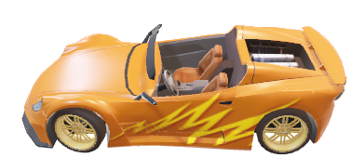
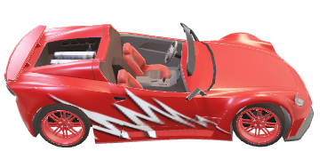
What is V2V?

Slide 3
Why V2V?!

Slide 4

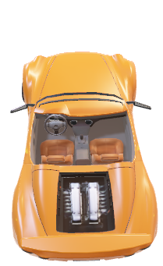
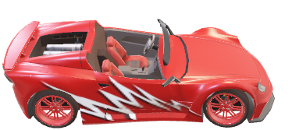
Without V2V

Slide 5

With V2V

Slide 6

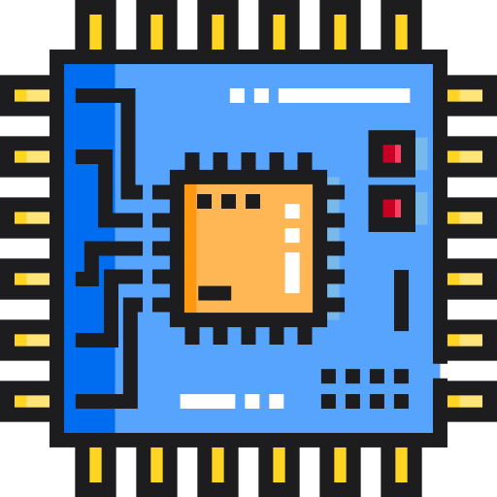
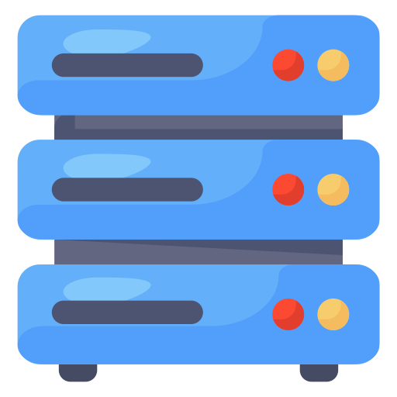
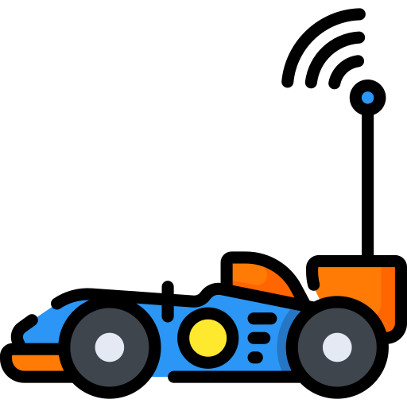
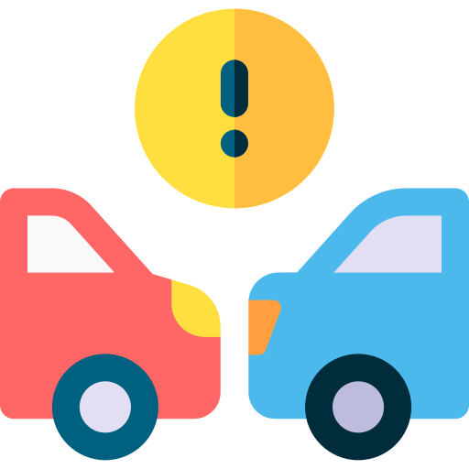
Simplex
Drivers
V2V
Duplex
Interface
Multiple Files
Analysis
Multiple Clients
Integration
Prototype
CAN

Slide 7
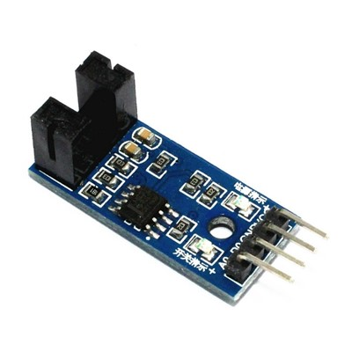
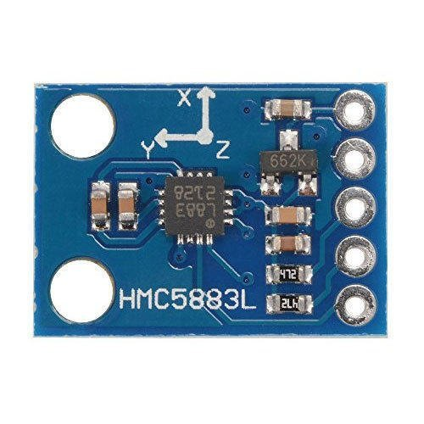
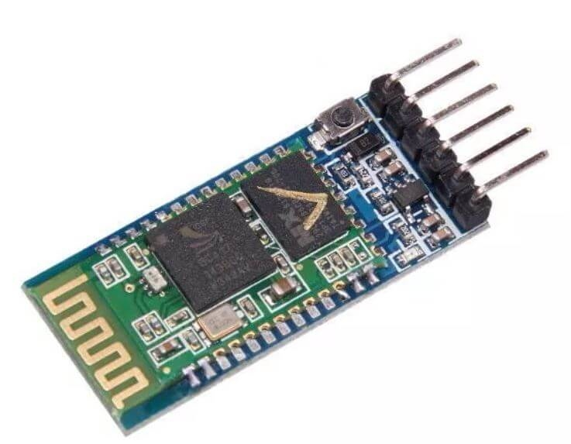
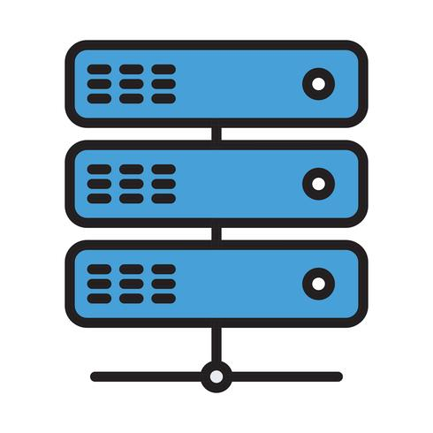
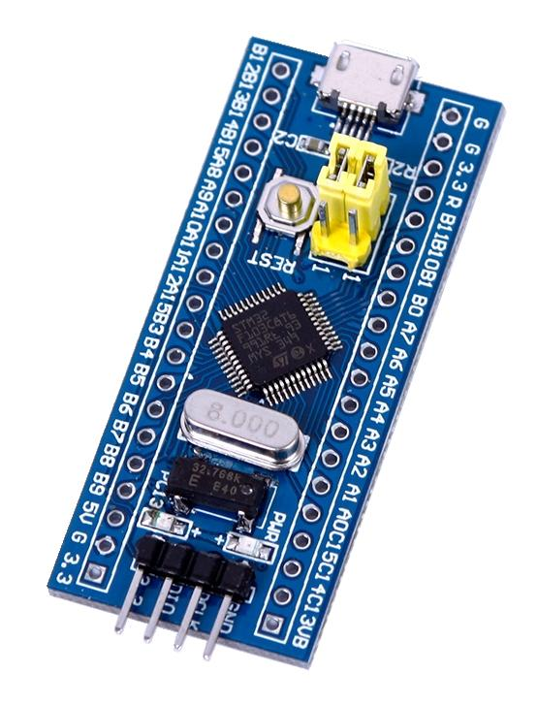
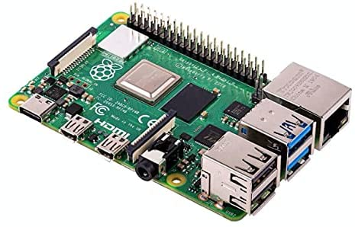

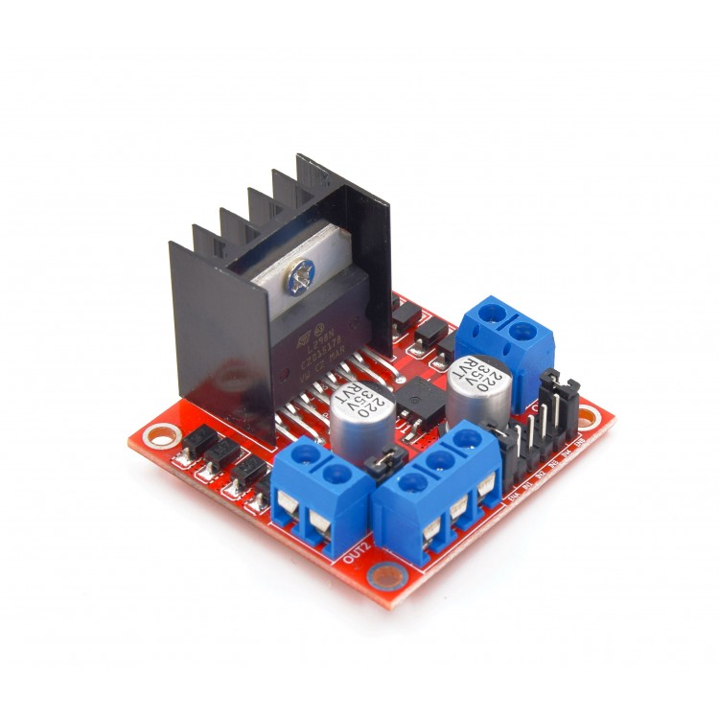
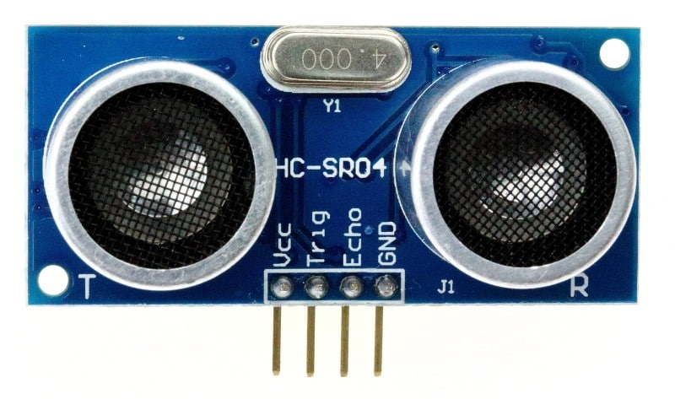
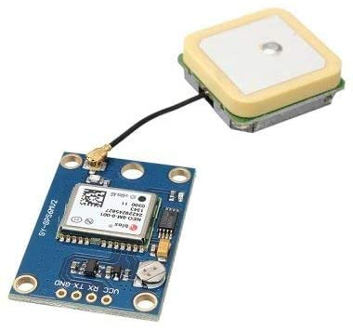
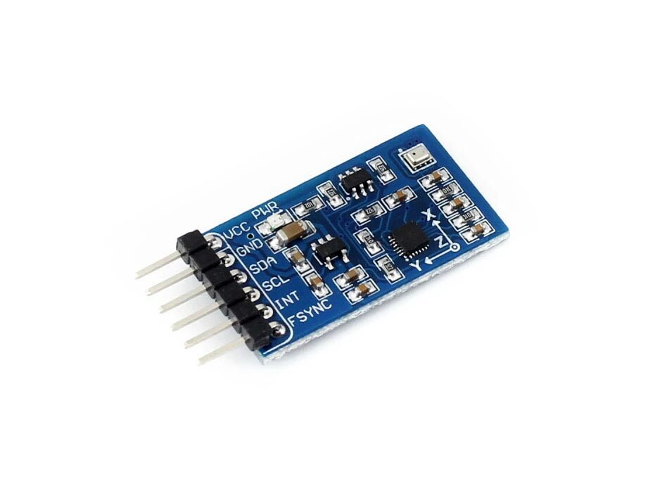
Bluetooth Module
Encoder
Compass
Timer
Server
UART
I2C
Raspberry Pi
Wi-Fi
CAN
UART
Timer
STM32
STM32
Admin
X2
Motor Driver
UART
I2C
Timer
GPS Module
IMU
X2
Ultra Sonic

Slide 8
Bluetooth Module
Encoder
Compass
Timer
I2C
Raspberry Pi
Server
UART
Wi-Fi
CAN
UART
STM32
Timer
STM32
Admin
X2
UART
I2C
Motor Driver
Timer
GPS Module
IMU
X2
Ultra Sonic

Slide 10
Location Measurement Unit
GPS
Ultra Sonic

Slide 11


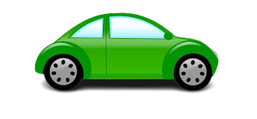
1. GPS
D1
Dx
D2
D = t * c

Slide 12


Slide 13

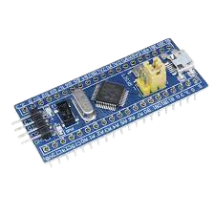
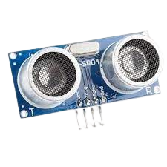
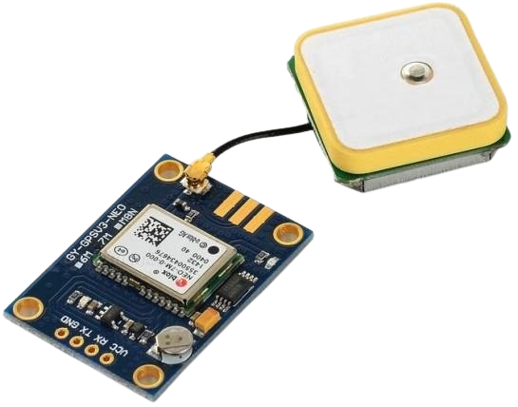

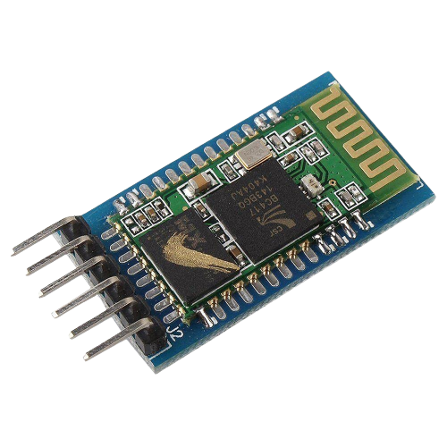
Timer
UART
Bluetooth
GPS module problem
Ultra Sonic Sensor
GPS Accuracy

Slide 14
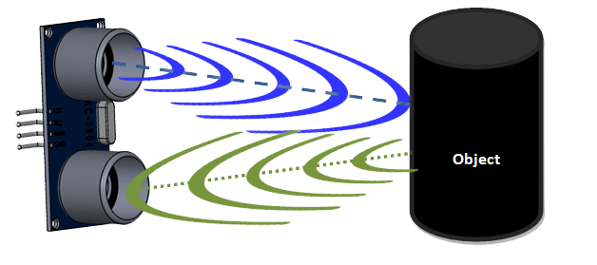
2. Ultra Sonic Sensor
2D = 2t * Sound_Speed
D = (2t) / 2 * Sound_Speed
Chirp
t
t
Echo

Slide 15
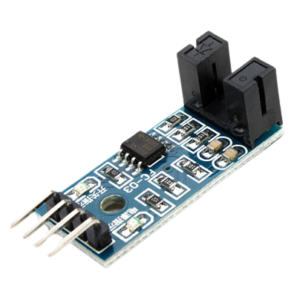
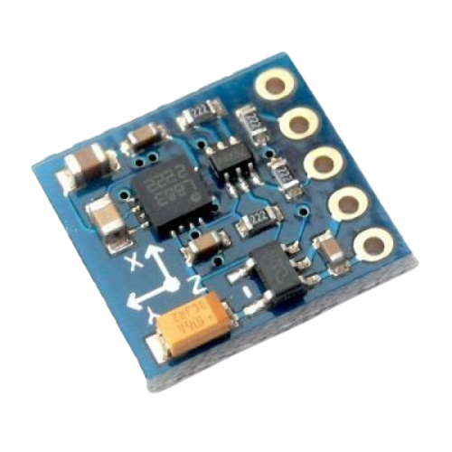
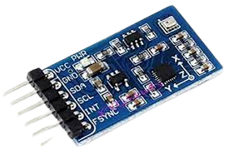
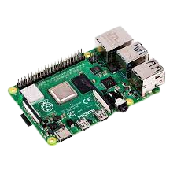
Analysis
Speed Components
Acceleration
components
Longitude, Latitude
Angle
V2V Data Frame
Analysis

Slide 16
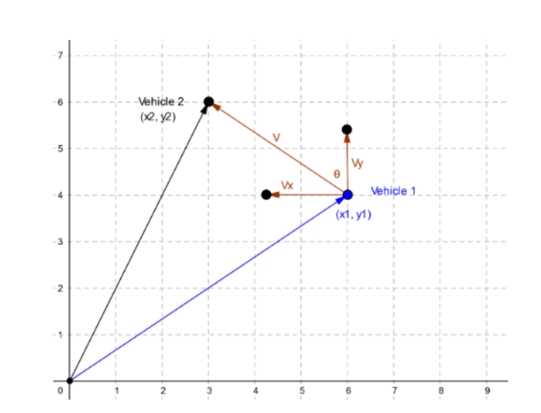
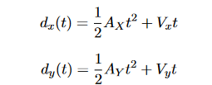

Slide 17
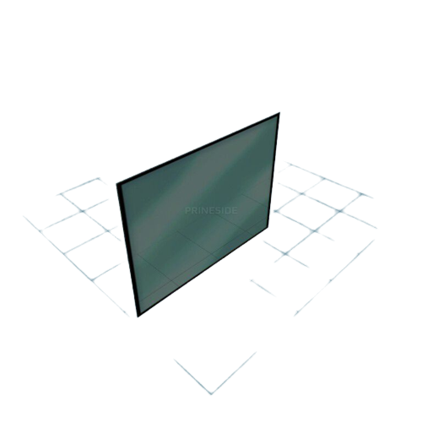
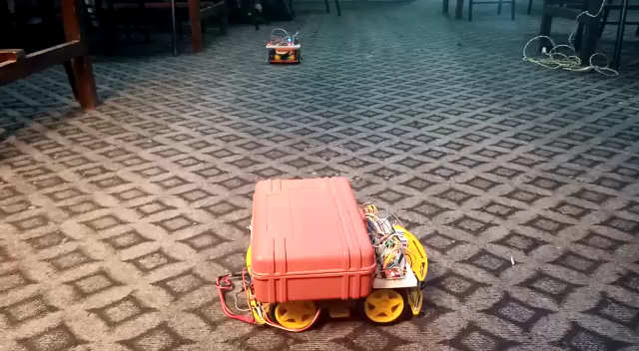
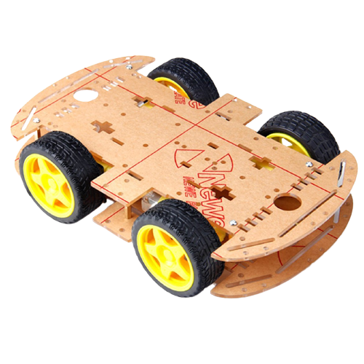
Ultra Sonic With Analysis

Slide 18
Bluetooth Module
Encoder
Compass
Timer
Server
UART
I2C
Raspberry Pi
Wi-Fi
CAN
UART
Timer
STM32
STM32
Admin
X2
Motor Driver
UART
I2C
Timer
GPS Module
IMU
X2
Ultra Sonic

Slide 19
Bluetooth Module
Server
UART
Raspberry Pi
Wi-Fi
CAN
Timer
STM32
Admin
X2
Motor Driver
Encoder
Compass
Timer
I2C
UART
STM32
UART
I2C
Timer
GPS Module
IMU
X2
Ultra Sonic

Slide 20

V2V Server Implementation

Slide 21


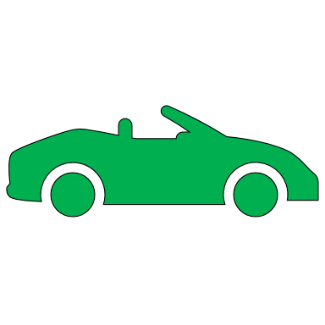

How are these vehicles linked?
The link is created via Wi-Fi network and a server that organizes messaging between different cars.
Vehicle 1 WI-FI Server WI-FI Vehicle 2

Slide 22


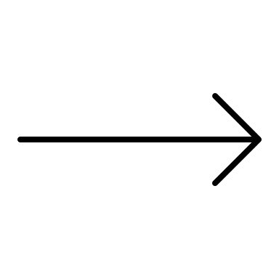


Socket programming
Socket programming is a way of connecting two nodes on a network to communicate with each other. One socket(node) listens on a particular port at an IP, while the other socket reaches out to the other to form a connection.
Client 1
Server
Client 3
Client 2

Slide 23
How does a socket work
Typical system configuration places the server on one machine, with the clients on other machines. The clients connect to the server, exchange information, and then disconnect.

Slide 24





Server socket
socket()
bind()
listen()
accept()
send(), recv(), read(), write()

Slide 25
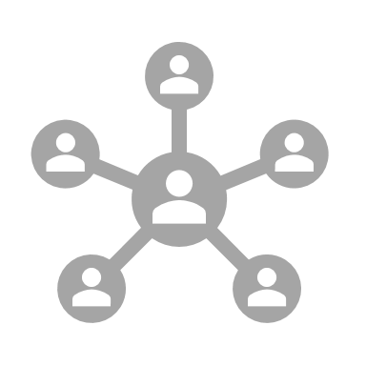

Client socket
socket()
connect()
send(), recv(), read(), write()

Slide 26



Why TCP?
connection-oriented protocol.
Sequential
built-in systems to check for errors

Slide 27



Socket evolution
1. Echo server
Server socket
Client socket

Slide 28


2. Simplex
3. Duplex

Slide 29
Two end devices can talk to each other
What's next?

Slide 30
To this point, end device can send only one file at a time.
This calls for more modifications or an upgrade.

Slide 31
Send file sequentially?
Send files one by one
Buffer object

Slide 32
Multiple clients

Slide 33
This calls for 2 things
Observer Pattern
Parallel interaction

Slide 34
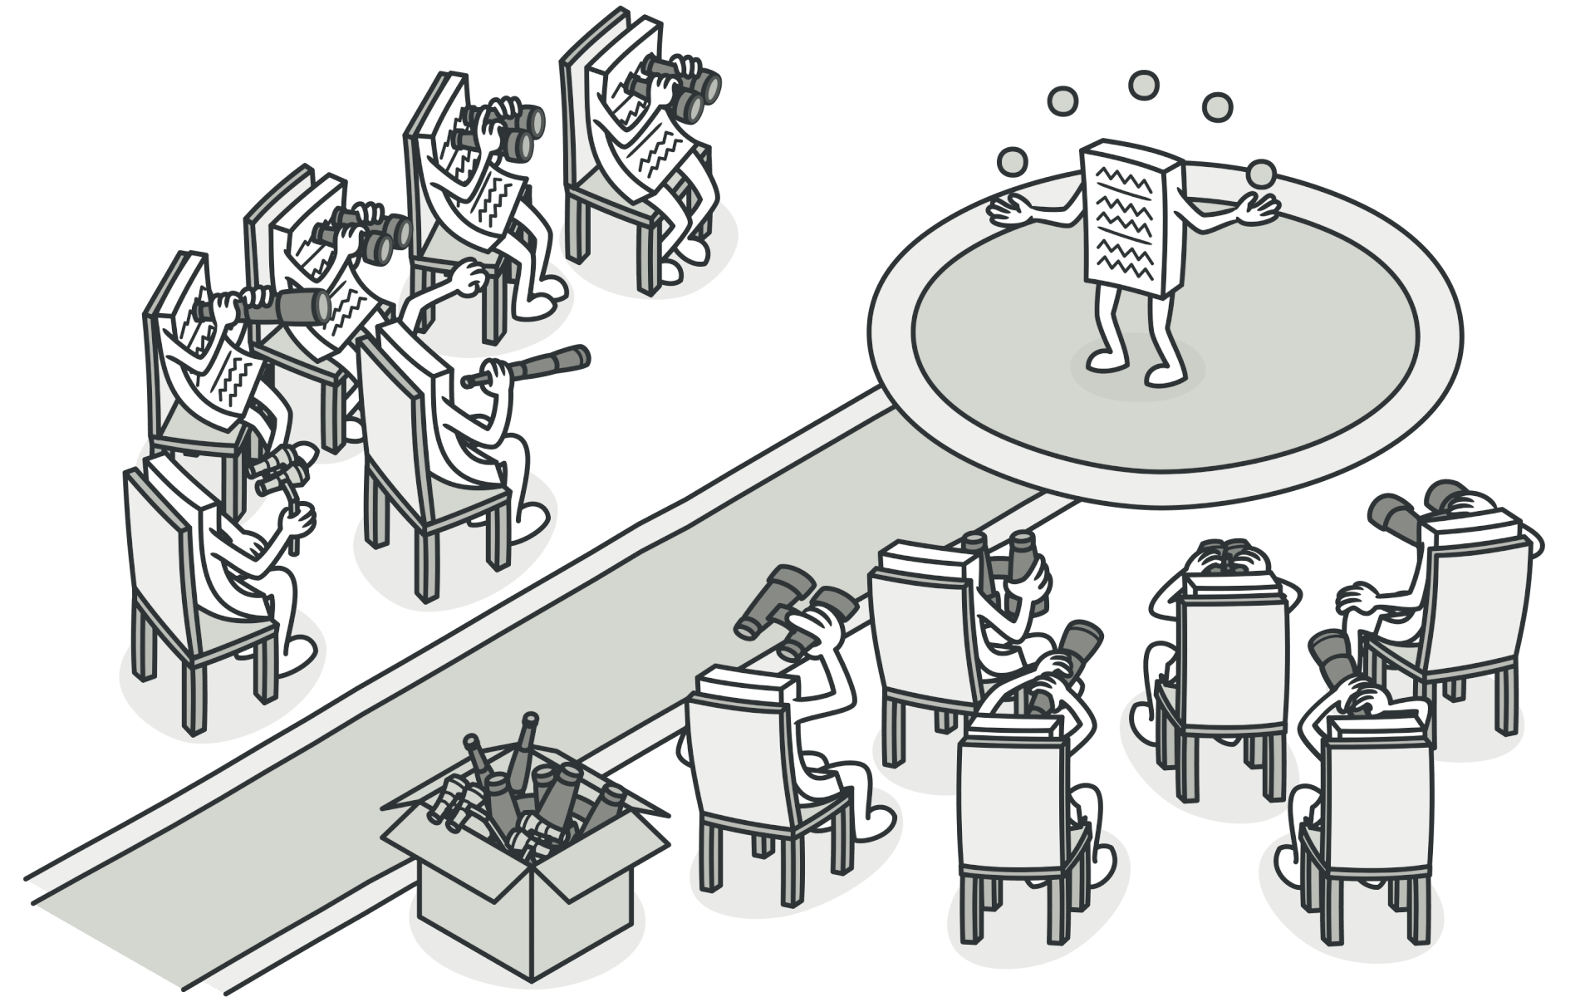
Observer Pattern
The observer pattern is a software design pattern in which an object, named the subject, maintains a list of its dependents, called observers, and notifies them automatically of any state changes, usually by calling one of their methods

Slide 35
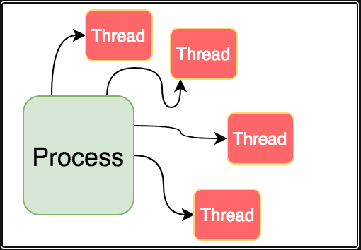
Threading

Slide 36
GUI
Graphical User Interface

Slide 37
Why GUI?
Up till now the project relies on (Terminal User Interface) TUI.
To make it appealing for everyday users, a GUI must be added.

Slide 38
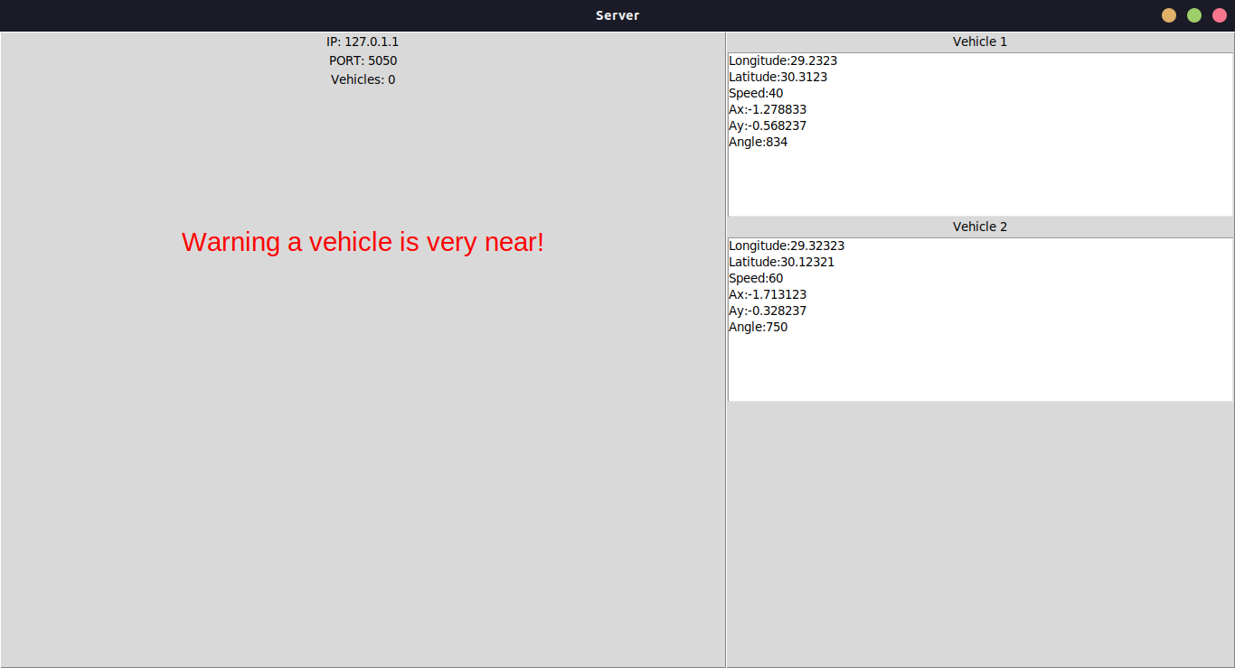

Slide 39
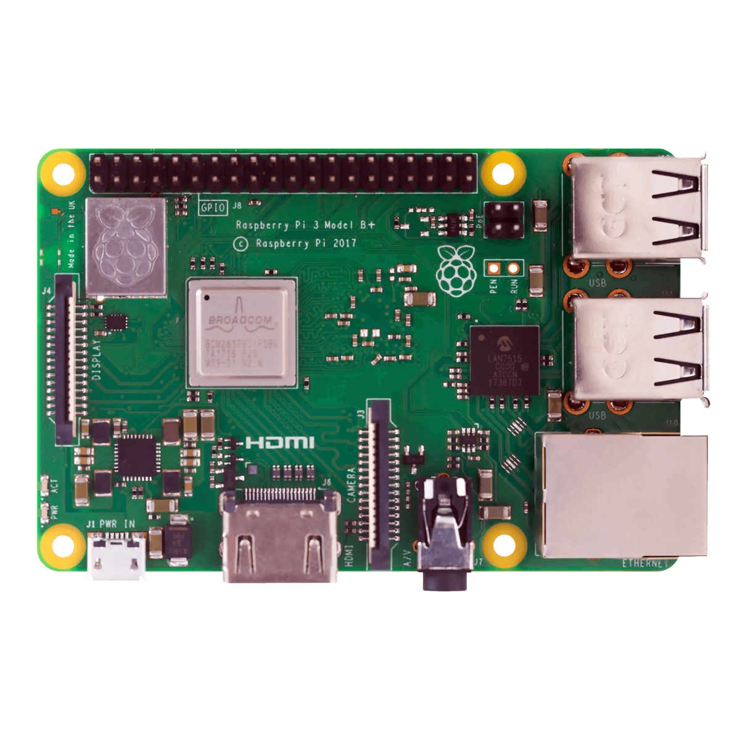
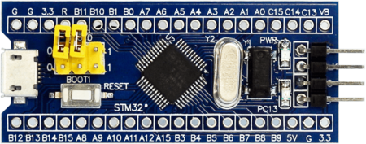
Embedded integration with JSON
Data

Slide 40

Data: “32,29,34, +10,-3,30,20,17”
JSON file

Slide 41
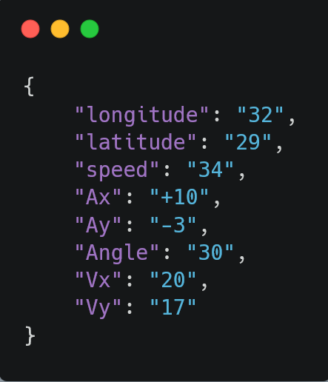
Structure of a JSON file

Slide 42
Embedded Integration with server

Slide 43
Embedded Integration with server

Slide 44
Data: “32,29,34, +10,-3,30,20,17”

Slide 45
Bluetooth Module
Encoder
Compass
Timer
Server
UART
I2C
Raspberry Pi
Wi-Fi
CAN
UART
Timer
STM32
STM32
Admin
X2
Motor Driver
UART
I2C
Timer
GPS Module
IMU
X2
Ultra Sonic

Slide 46
Bluetooth Module
Server
UART
Wi-Fi
CAN
Timer
STM32
STM32
Admin
X2
Motor Driver
Encoder
Compass
Timer
I2C
Raspberry Pi
UART
UART
I2C
Timer
GPS Module
IMU
X2
Ultra Sonic

Slide 47
FEATURES

Slide 48
RELIABILITY
MODULARITY
LOW COST
EASY TO INSTALL
EASY TO USE AND UNDERSTAND
UPDATEABLE

Slide 49

reliability

Slide 50
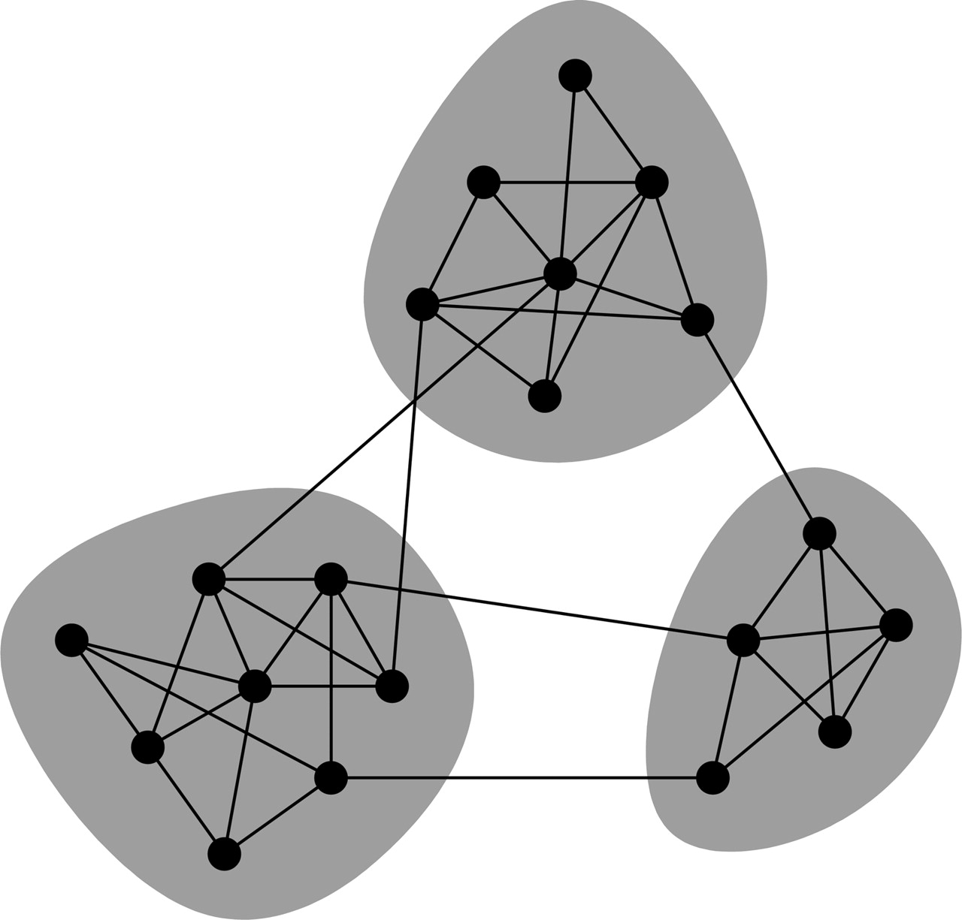

Modularity
A system of multi systems

Slide 51
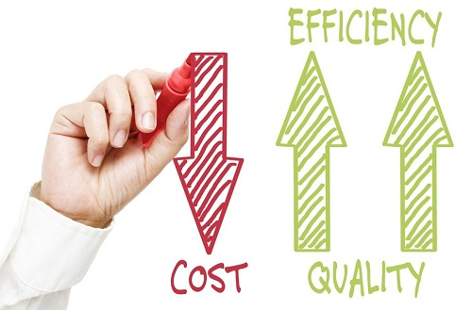
Low cost

Slide 52



Slide 53

Updateable

Slide 54
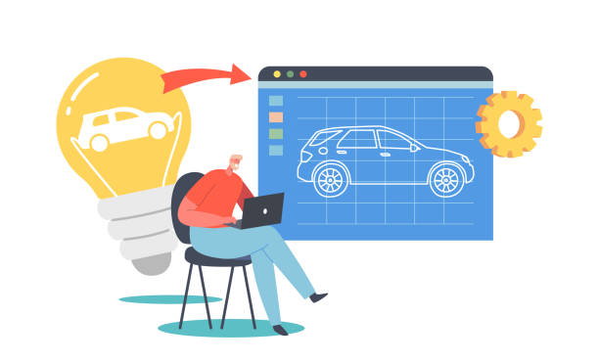
Hardware implementation
Prototype

Slide 55
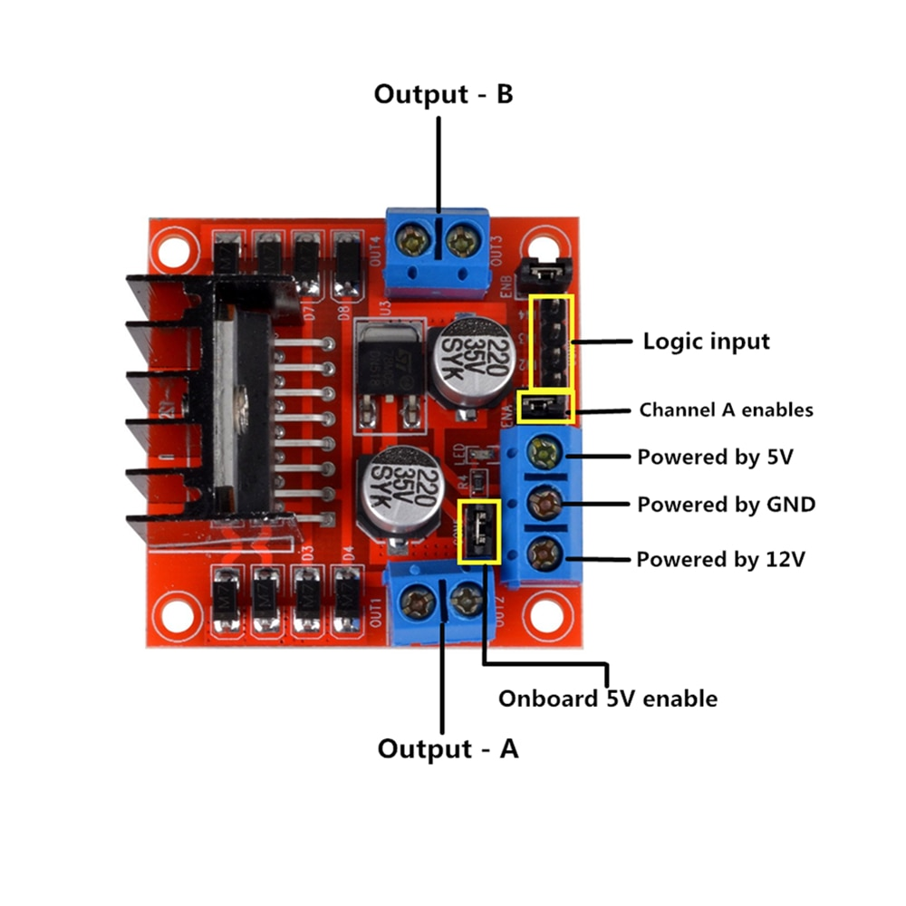
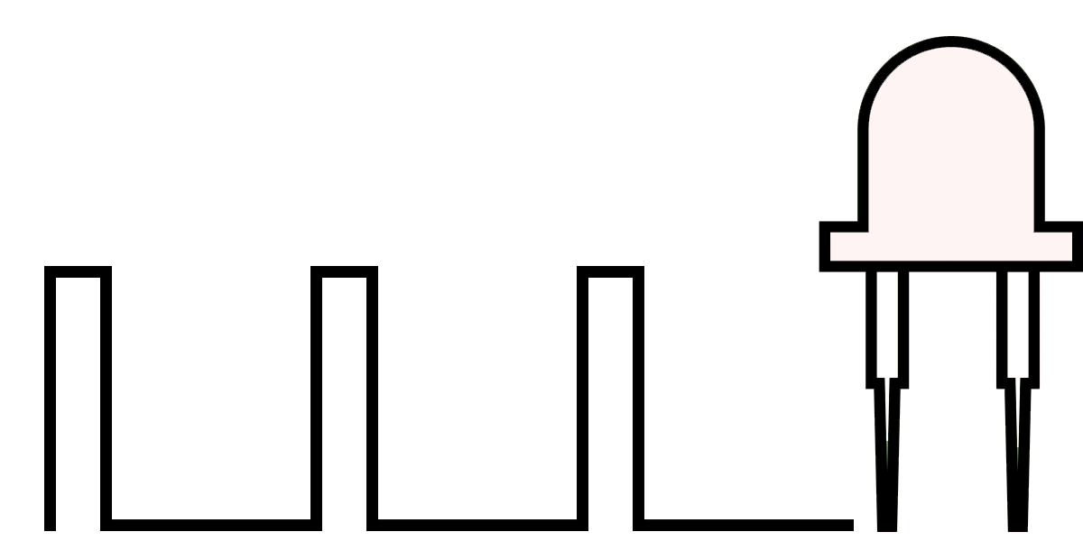
L298DN

Slide 56
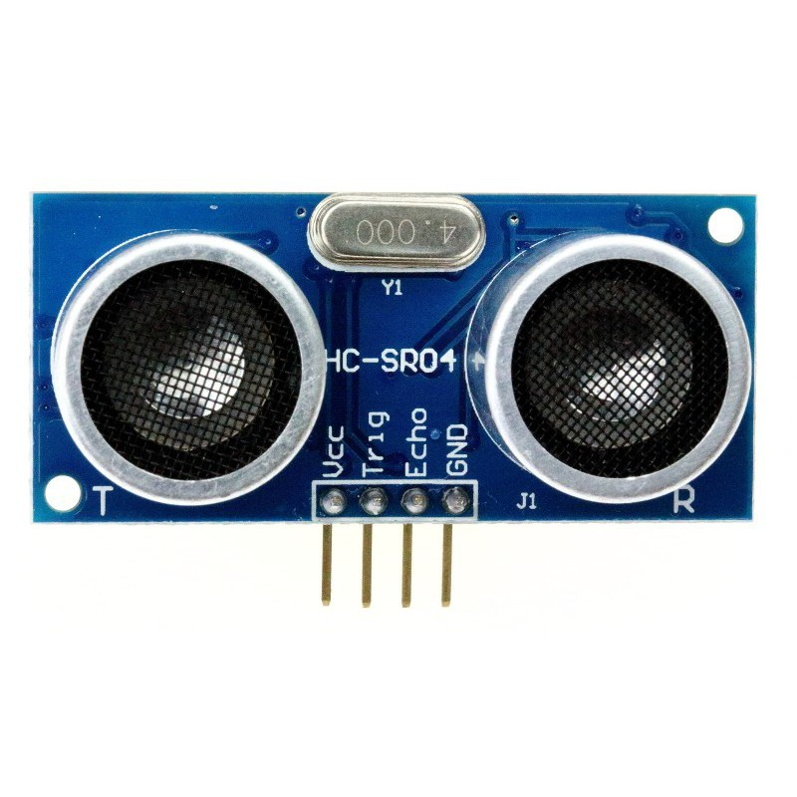
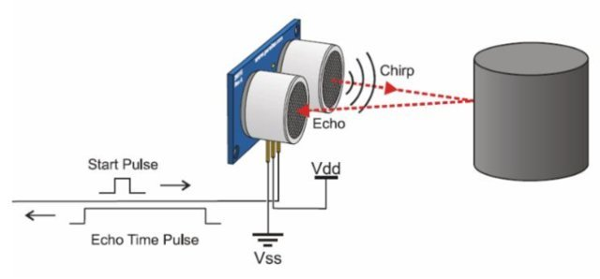
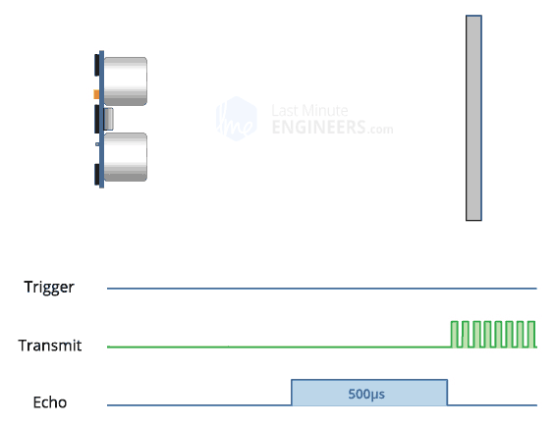
HC-RS04

Slide 57





Bluetooth module control

Slide 58

SCHEMATIC

Slide 59


PCB

Slide 60


V2X applications

Slide 61



Forward collision warning

Slide 62


Lane change warning

Slide 63


Blind spot warning

Slide 64
Future improvement

Slide 65





Emergency service warning

Slide 66

Traffic Management

Slide 67




Driver's rating

Slide 68

Mobile application

Slide 69

Virtual traffic lights

Slide 70

Crashes history

Slide 71

Road detection

Slide 72

Assisted self driving cars

